Slide 1
Submitted by :
Name : Mst. Fareya Azam
Roll no :1331
SPL-1 Presentation
CONTROL FLOW ANALYSIS
Supervised by:
Dr.Md.Sumon Ahmed
Associate Professor
Institute of Information Technology,DU

Slide 2
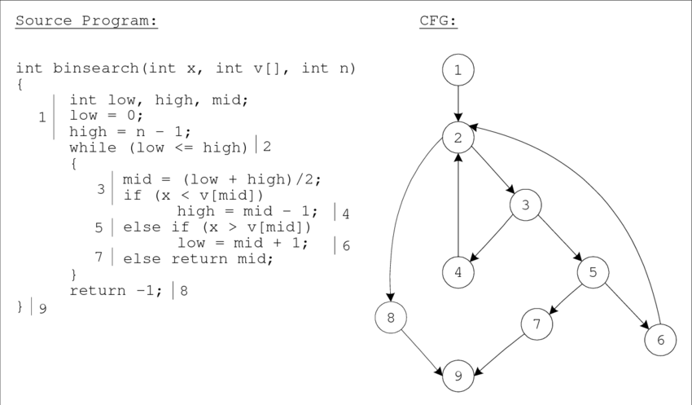
Introduction to my project
Source code
Control flow
graph

Slide 3
The project aims to develop a program that will take a source code file in C as input and generate its Control Flow Graph(CFG) as output . Later it will analyze the graph using BFS and DFS algorithm.
Here is the flow chart of my project :

Slide 4
Start here
Input C source code
Remove comments and tokenize the modified code
Identify structures
Create adjacency list and matrix
Create nodes and add edges
End
Using DFS and BFS on the graph find the required information
Print adjacency List,matrix and additional informations

Slide 5
The main steps involved in this project are:
• code analysis
• basic block identification
• edge creation.

Slide 6
This project takes the input source code and removes comments and tokenizes it.Then it stores the tokens in a txt file.
Later using this file, it finds the structures of control flow graph(if ,else if statement,loops etc).

Slide 7
This project creates nodes and add edges according to the stored information.Thus I have created adjacency list and adjacency matrix to represent the CFG using brute force approach.

Slide 8
I have implemented Depth first search (DFS) and Breadth first search(BFS)on the adjacency matrix to analyze the control flow graph.

Slide 9
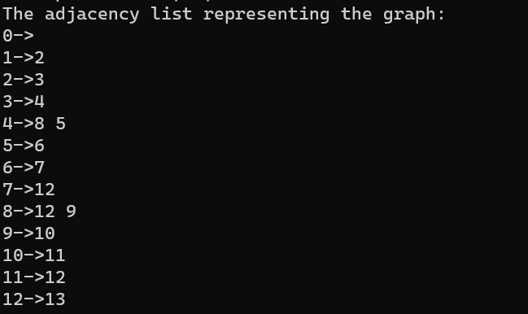
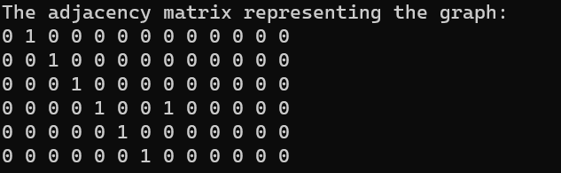
The code will show output in the following format:

Slide 10
The BFS and DFS algorithm implementation will show us some valuable information like parent node,source node,node traversal starting time,finishing time,color vector of visited and unvisited nodes,distance from source etc.

Slide 11
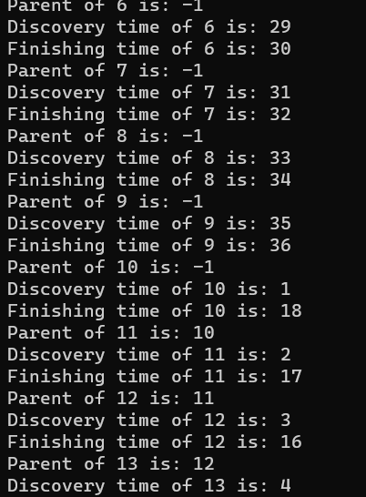
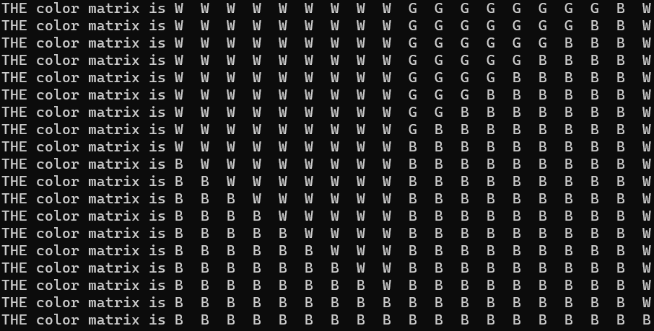
Here is the output of the graph analyzation technic :

Slide 12
Conclusion
This project, from the problem solving point of view is very interesting to me.It has increased my understanding power of the control flow within a program.Though, now it can handle simple program, I think by adding more features it will be more helpful and optimized.

Slide 13


